Slide 1

Vidhyadhan Charitable Trust
SMT Z.S Patel College of Computer Application
Affiliated to, Veer Narmad South Gujarat University, Surat
Quizara – Learn, Play, Achieve
Presented By. | Manani Suraj Vinodbhai - 5240 | Mandaliya Raj Manojbhai - 5241
Guided By. | Mrs. Dhvani Ma’am & Mrs. Reema Ma’am
Group No. | 11

Slide 2
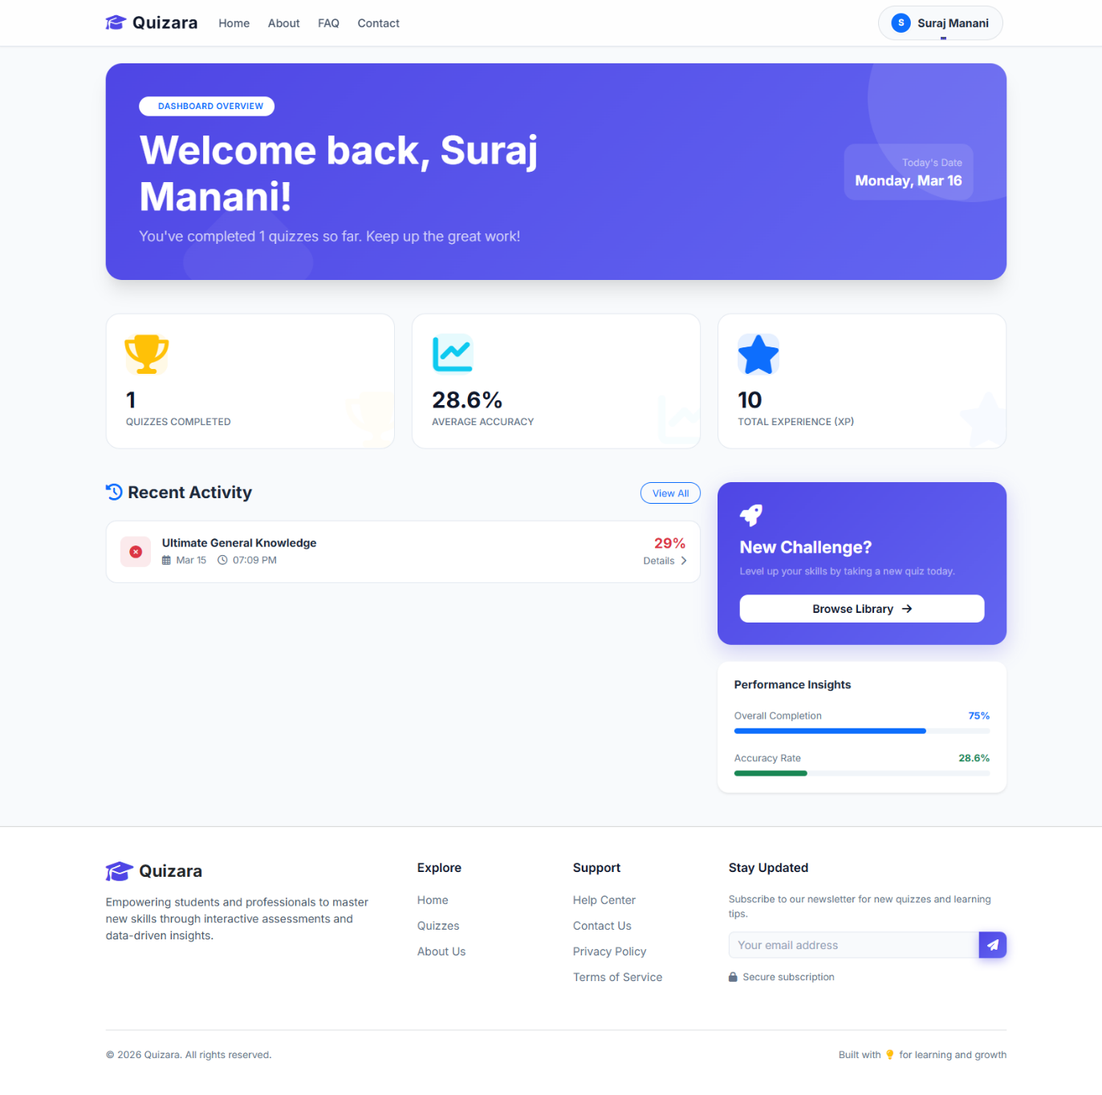
Introduction
Quizara is a web-based quiz platform.
Designed for online learning & assessment.
Provides modern & user-friendly interface.
Supports:
1). Student Portal
2). Admin Portal

Slide 3
Problem Statement
01
02
03
04
Traditional exams are time-consuming.
Chances of human errors.
No instant feedback
Hard to track student performance

Slide 4
Project Objectives
Quiz
Build secure quiz platform.
Provide instant results.
Track student performance.
Implement role-based access.
Generate certificates automatically.
Attempt
Result
Certificate

Slide 5
Technology Stack
01
02
Frontend: HTML, CSS, JavaScript
Backend: PHP 8.x
03
04
Styling: Bootstrap 5, Custom CSS
Database: MySQL

Slide 6
Libraries
01
02
PHPMailer → Emails
FPDF → Certificates
03
FontAwesome → Icons

Slide 7
System Architecture
Users
Type: Multi-Page Application (MPA).
Authentication: Admin & Student login.
Session Handling: PHP Sessions.
Database: PDO (secure queries).
Security: Role-based access (RBAC).
Server
Database

Slide 8
Student Portal Features
Dashboard (XP, scores, attempts)
Attempt history
Online quizzes (MCQ, True/False)
Leaderboard (Top users)
Certificate generation (>75%)

Slide 9
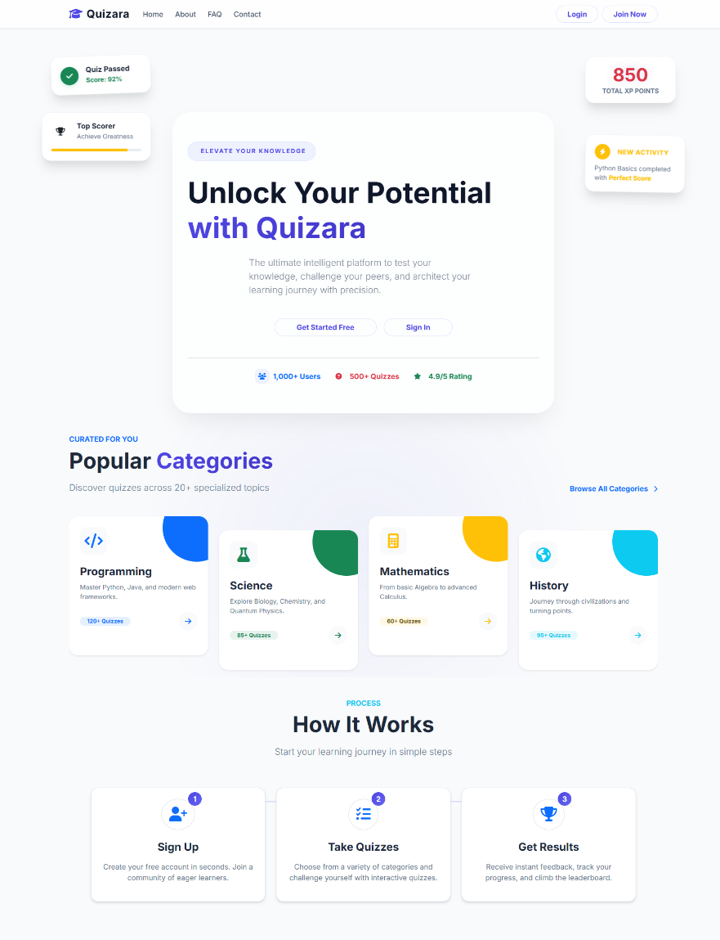
Home & Dashboard Page

Slide 10
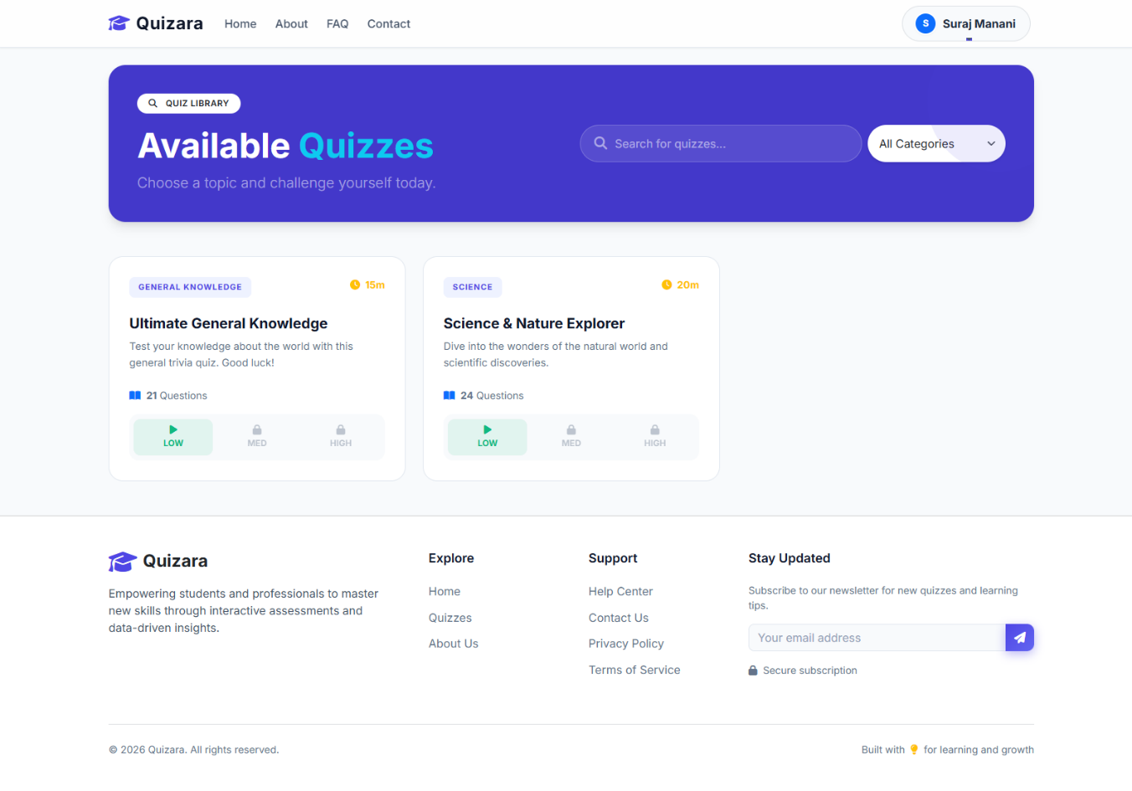
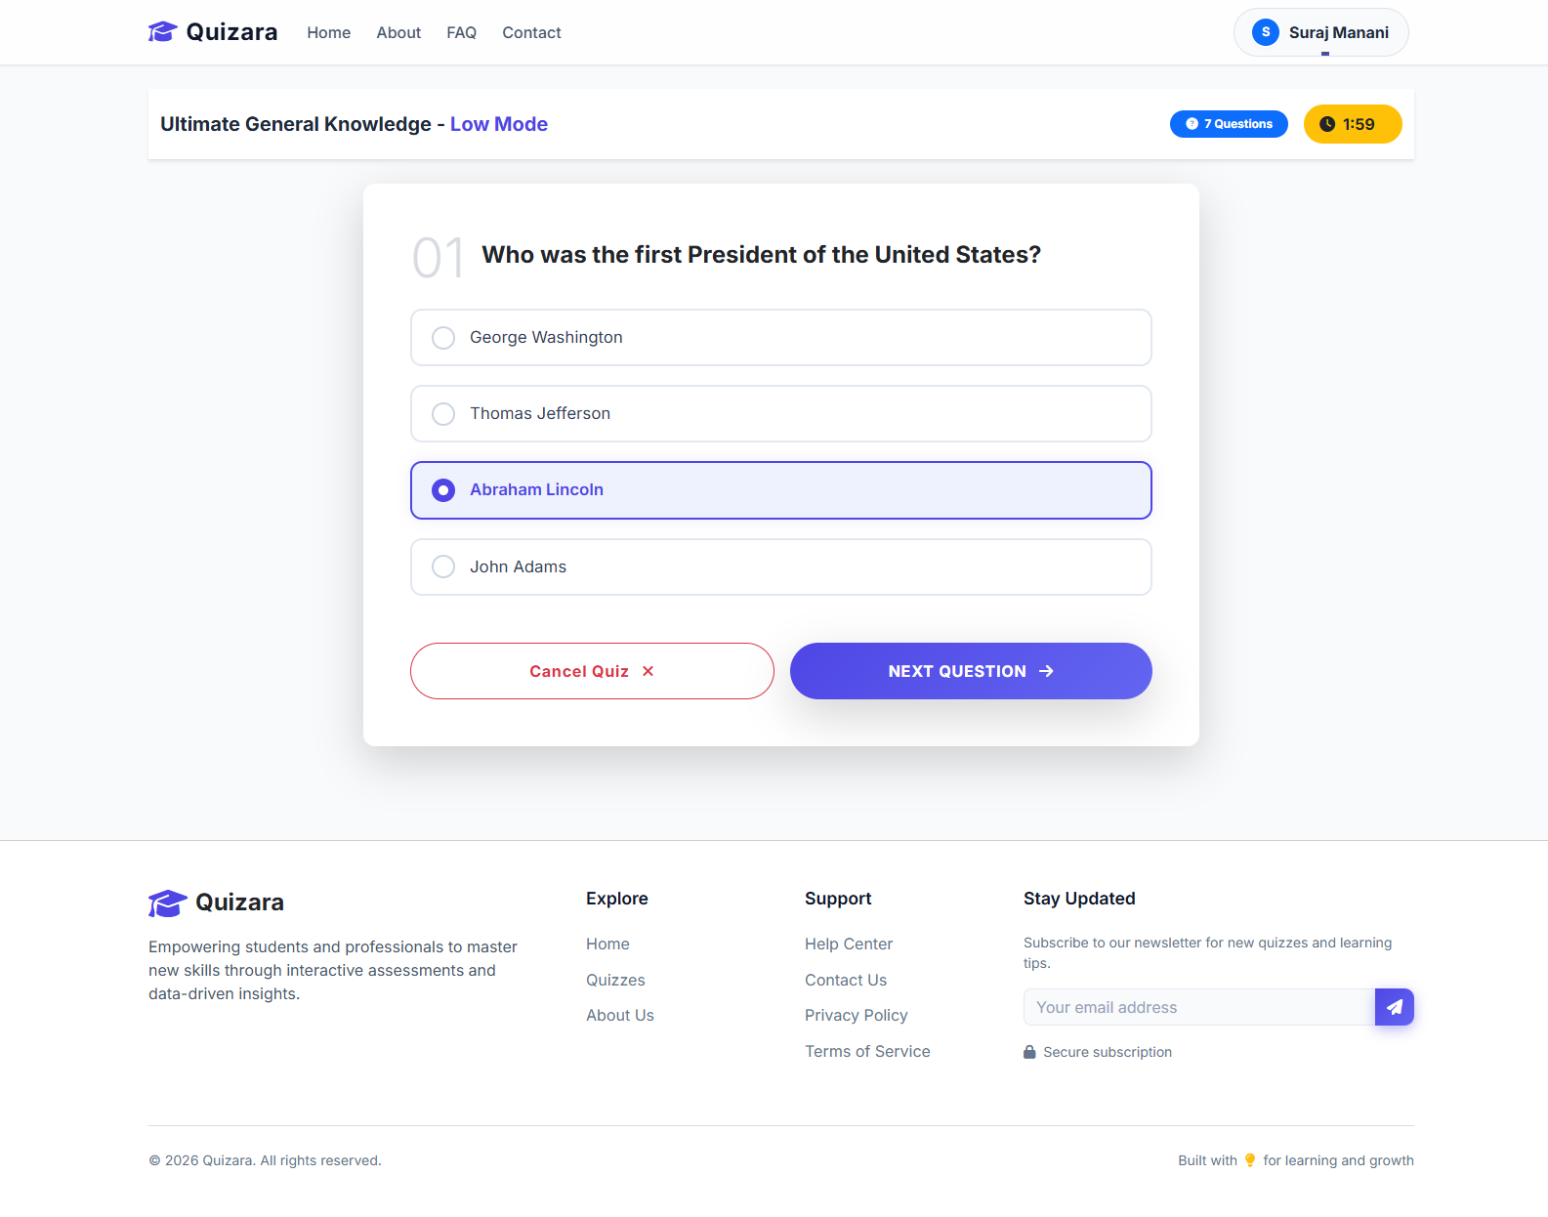
Quizzes Page

Slide 11
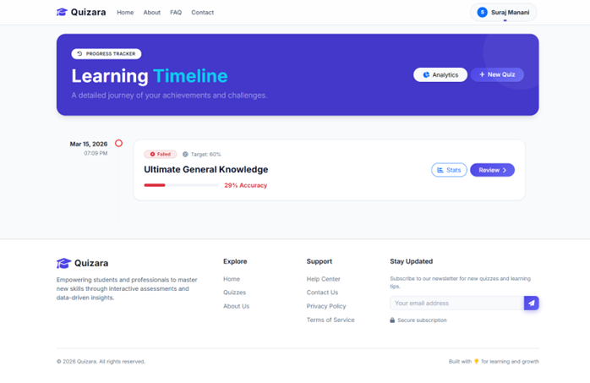
Quizzes History

Slide 12
Admin Portal Features
Admin dashboard (analytics)
Quiz management (CRUD)
User management
Performance reports
System settings

Slide 13
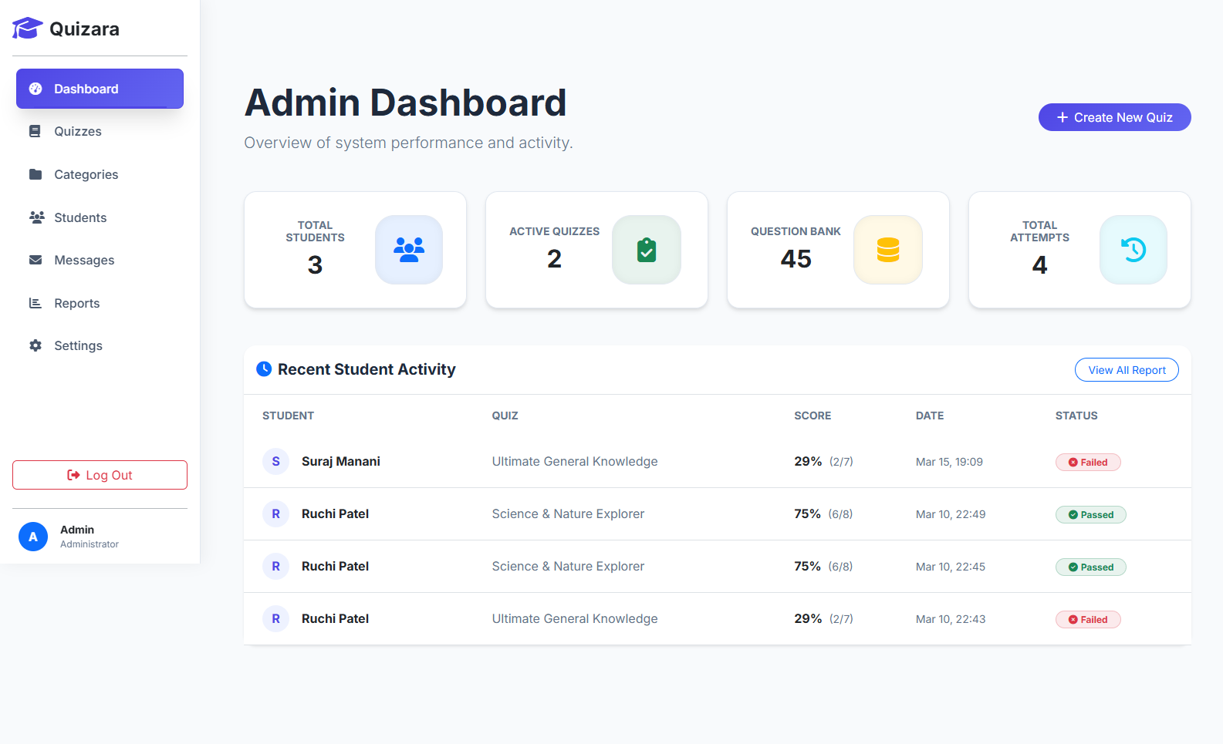
Admin Dashboard

Slide 14
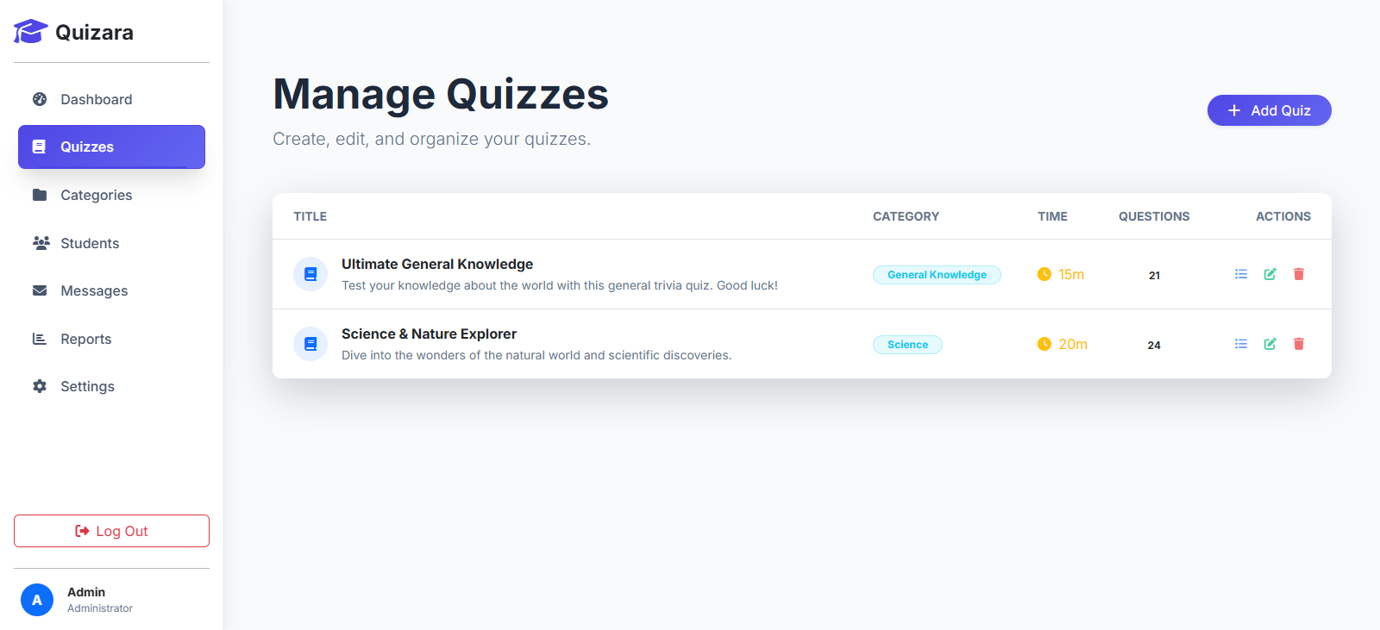
Manage Quizzes

Slide 15
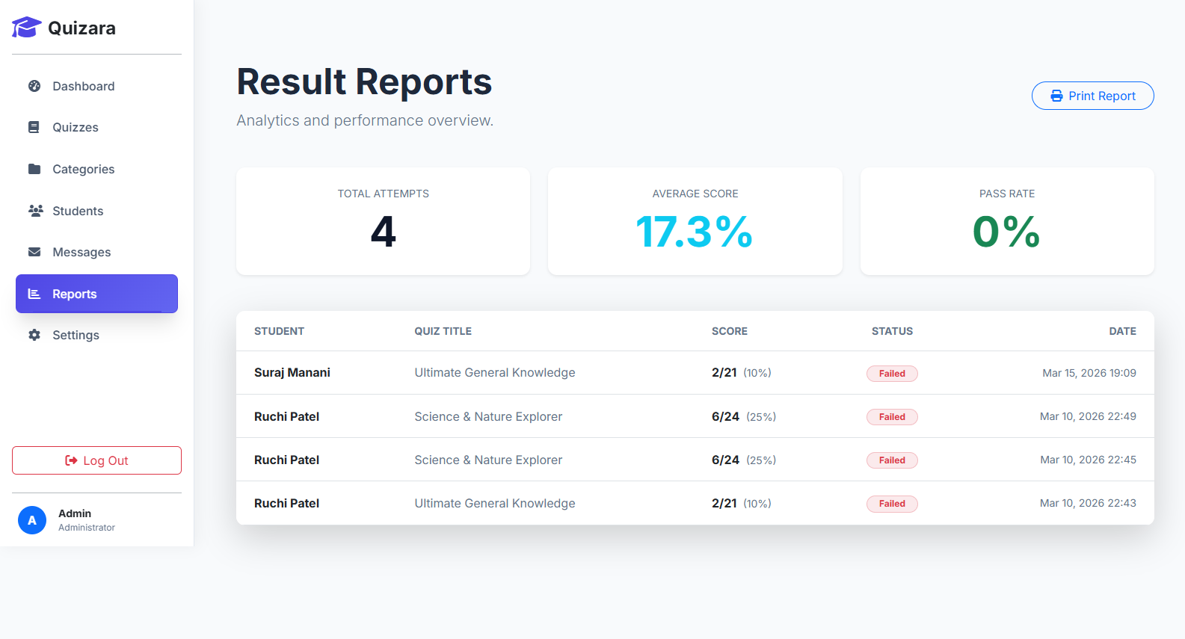
User Reports

Slide 16
Security & Integration
SQL Injection prevention (PDO).
Password hashing (secure login).
Email System (SMTP):
1). Registration emails
2). Password reset (15 min token)
3). Quiz results

Slide 17
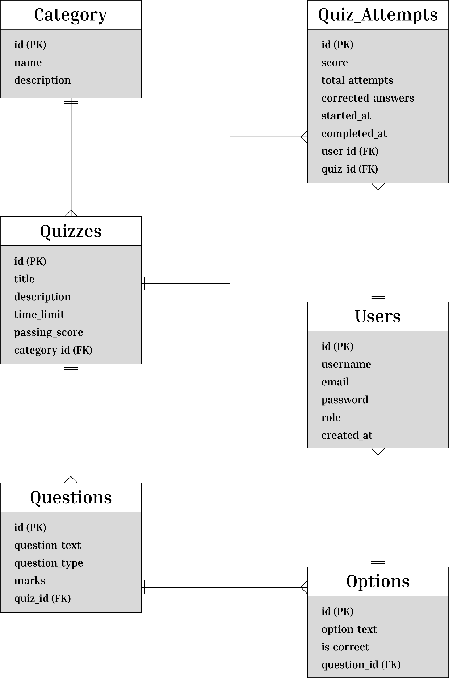
Database Design
users
category
quizzes
questions
options
quiz_attempts
quizara_db

Slide 18
Future Scope
Live quiz timer
Real-time leaderboard
Gamification (badges, rewards)
Mobile app development
AI-based question generation

Slide 19
Conclusion
Quizara is secure & efficient.
Reduces manual work.
Improves learning experience.
Ready for future expansion.

Slide 20
Thank You!

